Slide 1

#RahoAmbitious
TechM Full-Stack Software Development

Slide 2




Course: Software Testing
Lecture On: Testing Frameworks and Introduction to Back-End Automation
Instructor: Bibek Prasad

Slide 3
In the previous class, we covered…
Selenium WebDriver and its architecture
How to write a Selenium automation script for a web page

Slide 4



Poll 1 (15 Sec)
What is true about @BeforeTest in TestNG?
The test annotated by @BeforeTest will run before all the tests belonging to a particular class run.
The test annotated by @BeforeTest will run before all the tests in the test suite.
The test annotated by @BeforeTest will run before all the tests belonging to a particular method run.
The test annotated by @BeforeTest will run before all the tests.
Practice in teams of 4 students
Industry expert mentoring to learn better
Get personalised feedback for improvements

Slide 5
Poll 1 (Answer)
What is true about @BeforeTest in TestNG?
The test annotated by @BeforeTest will run before all the tests belonging to a particular class run.
The test annotated by @BeforeTest will run before all the tests in the test suite.
The test annotated by @BeforeTest will run before all the tests belonging to a particular method run.
The test annotated by @BeforeTest will run before all the tests.
Practice in teams of 4 students
Industry expert mentoring to learn better
Get personalised feedback for improvements

Slide 6

Today’s Agenda
1
Testing Frameworks
2
Page Object Model
3
Introduction to Back-End Testing

Slide 7
Explicit and Implicit Wait

Slide 8
Implicit and Explicit Wait
Most of the web pages use AJAX calls and JavaScript, and thus, it may take some time to load the content on the web page because of which if your script is trying to find an element that has not been loaded, then the script will throw an exception. To avoid such a scenario, you need to use wait.
Wait is of the following two types:
Implicit wait: Here, the WebDriver is asked to wait for a specified amount of time before it throws 'NoSuchElementException'
Explicit wait: Here, the WebDriver is asked to wait until a certain condition is executed or the maximum allotted time gets exceeded, and only then, it throws 'ElementNotVisibileException'.
driver.manage().timeouts().implicitlyWait(TimeOut, TimeUnit.SECONDS);
WebDriverWait wait = new WebDriverWait (WebDriverRefrence,TimeOut);

Slide 9
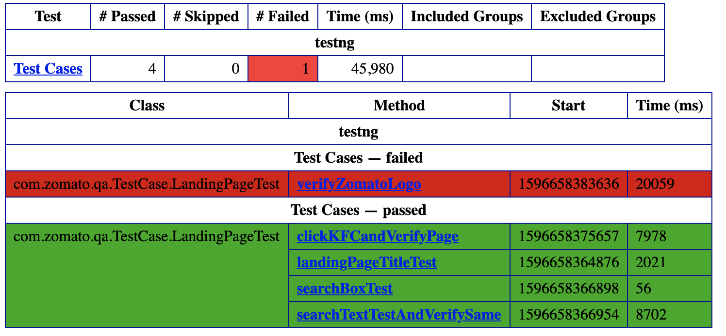
TestNG reports

Slide 10
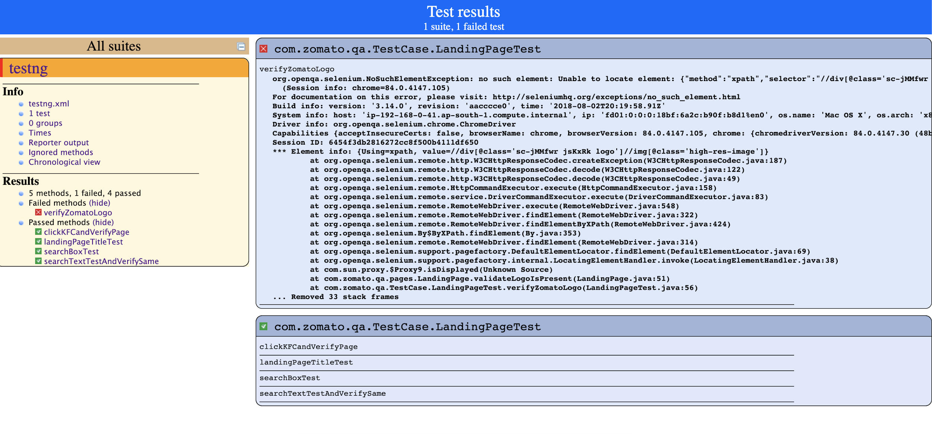
TestNG reports

Slide 11
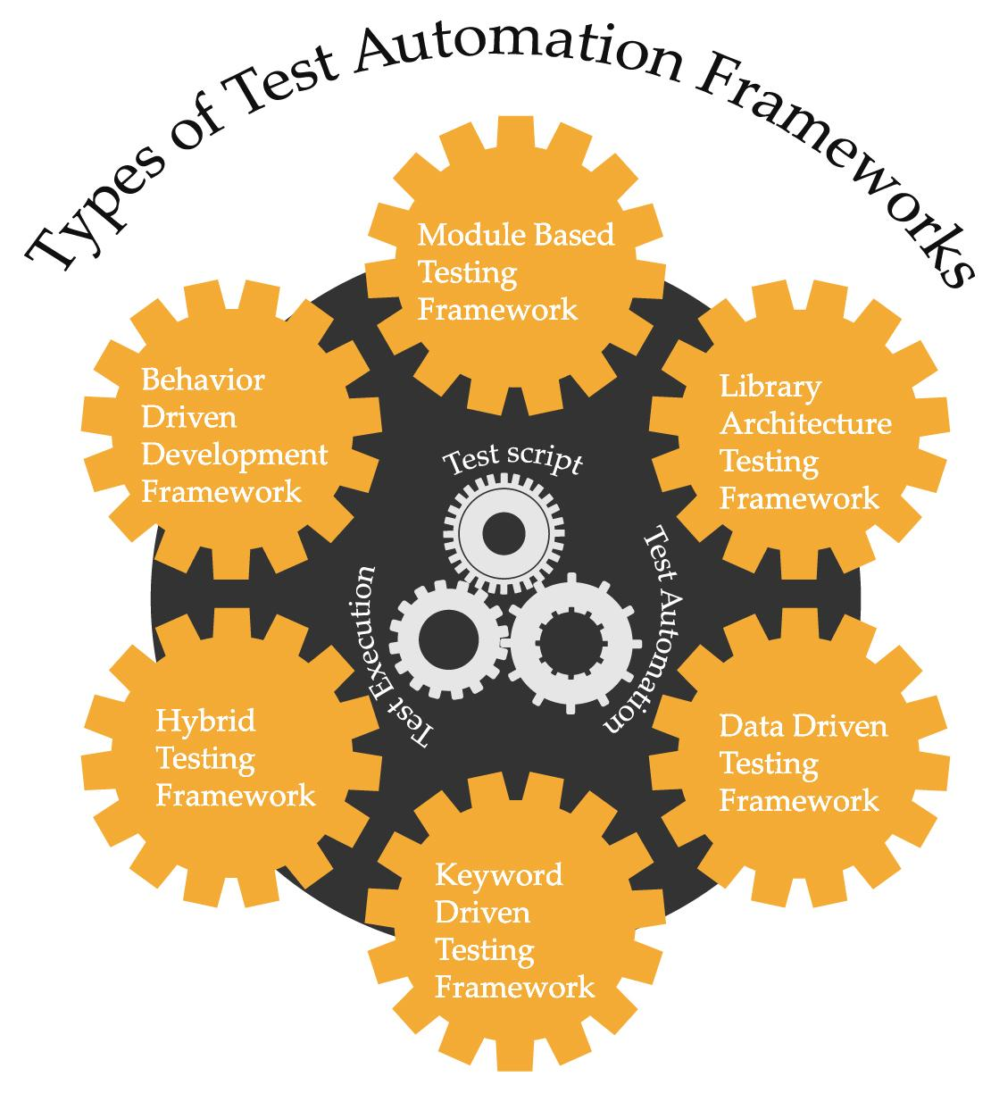
Testing Frameworks

Slide 12
Testing Frameworks
What Is a Framework?
A framework is a set of rules/guidelines that produces effective results when followed.
Let’s consider a simple example given below to understand it better.
Suppose you are taking part in a marathon. During its registration, you are given a pamphlet that mentions the following guidelines.
Please bring your own water bottle and towel.
Please wear a comfortable pair of running shoes.
Please wear comfortable exercise tracks and t-shirt.
Now, if you do not follow the given guidelines, you can still participate in the marathon. However, if you follow the given guidelines, it would be helpful for you, and you would be able to perform better.
Thus, you need to follow certain guidelines while building your project so that it produces effective outputs.

Slide 13
Testing Frameworks
Test Automation Framework
A test automation framework is a set of rules that is used for building test cases. It provides a better environment for the execution of test scripts.
Frameworks help in developing, executing and reporting automation test scripts efficiently.
Certain questions that are answered while following any test automation framework are as follows:
Which coding standard is to be used?
How to handle test data?
Where to store test results?
Certain sets of rules that are used while automating a test case include the following advantages.
Code reusability
Improved efficiency
Least manual intervention
Low cost

Slide 14
Testing Frameworks
Different Types of Test Automation Frameworks
Testing Framework | Description
Linear Automation | It is also known as ‘Record and Playback Framework’. Here, the tester records each step in the first round and then plays the recorded script.
Module-Based Automation | In this framework, the test script is divided into smaller modules, and each module is tested as a separate unit.
Data-Driven Automation | To avoid hard coding of the test data, you can use data-driven framework because it allows you to store the test data and test script separately.
Keyword-Driven Automation | It is an extension of data-driven framework, where, apart from segregating the test data and test script, it also keeps a certain set of test script code in an external file as keywords.
Hybrid Automation | It is a combination of data-driven and keyword-driven frameworks.

Slide 15
Poll 2 (15 Sec)
Which of the following is not a test automation framework?
Data-Driven Test Automation Framework
Module-Based Test Automation Framework
Non-Linear Test Automation Framework
Linear Test Automation Framework
Practice in teams of 4 students
Industry expert mentoring to learn better
Get personalised feedback for improvements

Slide 16
Poll 2 (Answer)
Which of the following is not a test automation framework?
Data-Driven Test Automation Framework
Module-Based Test Automation Framework
Non-Linear Test Automation Framework
Linear Test Automation Framework
Practice in teams of 4 students
Industry expert mentoring to learn better
Get personalised feedback for improvements

Slide 17

Data-Driven Test Automation Framework

Slide 18
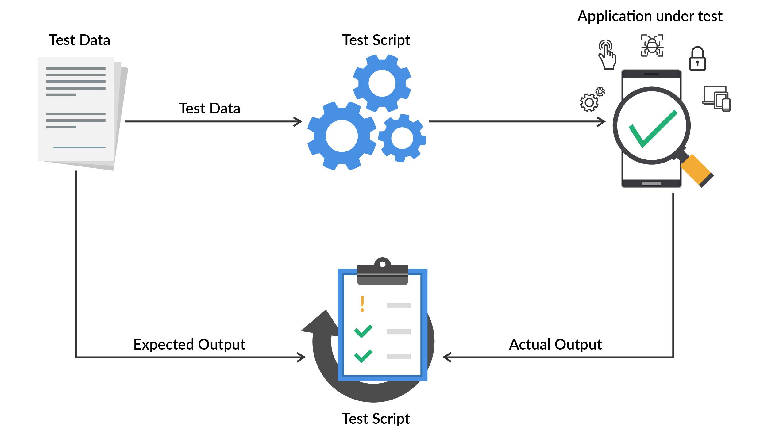
Testing Frameworks
What Is Data-Driven Framework?
In the data-driven test automation framework, the test data and test script are segregated.
The test data is stored in an external file such as text file, CSV, Excel file and XML file, and is loaded into the test script within a variable.

Slide 19
Testing Frameworks
Why Use Data-Driven Frameworks?
Data-driven testing reduces the cost of adding new tests, thereby providing you with an option to change them as per any change in your business rules. This is achieved by creating parameters for different scenarios with the help of data sets that will repeatedly run in the same code.
Data-driven testing helps you to identify which data is the most important for testing. It makes it easy for you to remember how something works whenever developers need to change anything.

Slide 20
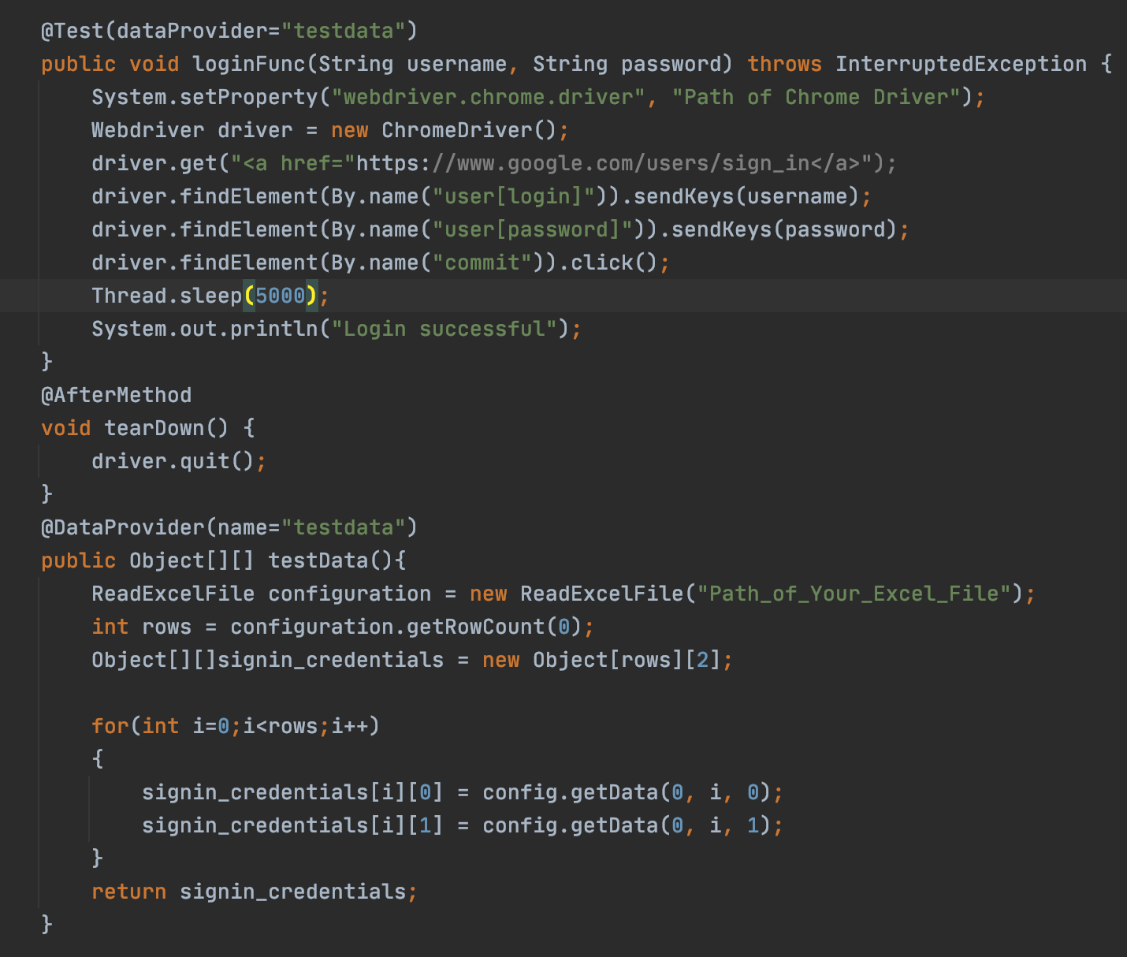
Data-Driven Frameworks

Slide 21
Poll 3 (15 Sec)
What, according to you, is an advantage of data-driven test automation framework? (Note: Multiple options may be correct.)
Same test scripts can be executed for different test data sets, thus covering all the test scenarios.
Changes in the test scripts will not impact the test data sets.
It is time-efficient and maintainable.
Setting up proper data-driven testing requires proficiency in multiple programming languages, and is time- and effort-consuming.
Practice in teams of 4 students
Industry expert mentoring to learn better
Get personalised feedback for improvements

Slide 22
Poll 3 (Answer)
What, according to you, is an advantage of data-driven test automation framework? (Note: Multiple options may be correct.)
Same test scripts can be executed for different test data sets, thus covering all the test scenarios.
Changes in the test scripts will not impact the test data sets.
It is time efficient and maintainable.
Setting up proper data-driven testing requires proficiency in multiple programming languages, and is time- and effort-consuming.
Practice in teams of 4 students
Industry expert mentoring to learn better
Get personalised feedback for improvements

Slide 23
Page Object Model
Page Object Model
Page Class
(consisting of the locators)
Test Script

Slide 24
Page Object Model (POM)
What Is POM?
Page Object Model (POM) is a design pattern that is used to automate test cases in Selenium.
In POM, every web page is represented as a page class, and various elements on a web page are defined as variables of that page class. All possible user interactions on a particular web page are then implemented as page methods of the page class. This structure of a testing framework is known as page object model, or POM.
Page Object Model
Page Class
(consisting of the locators)
Test Script

Slide 25
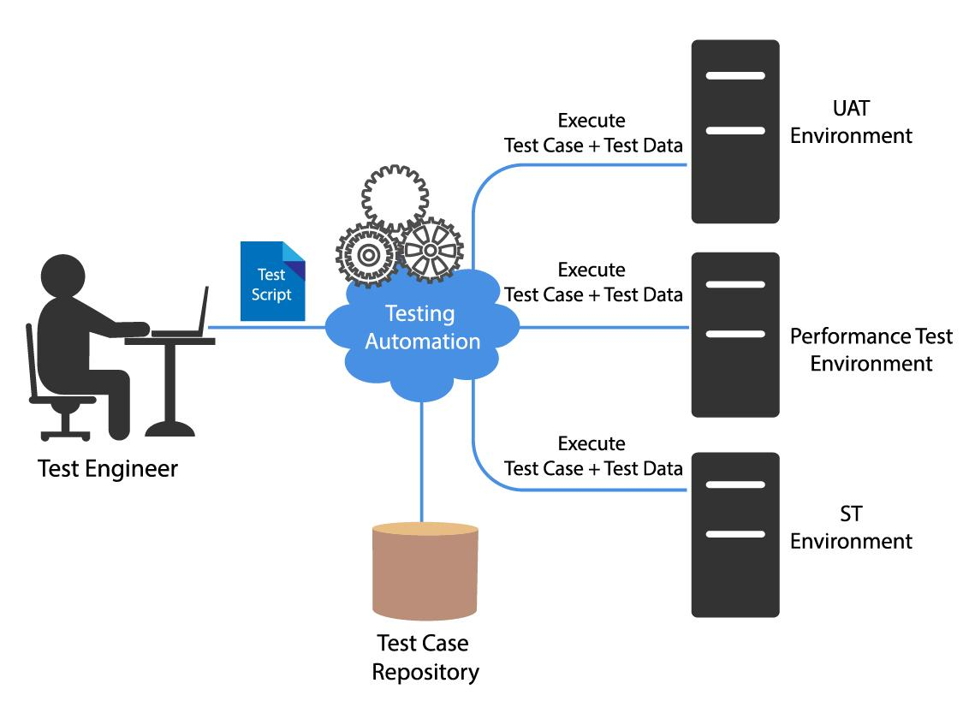
Page Object Model (POM)
Why Use POM?
Reusability:
The page class consists of the locators on a particular web page. Hence, you can use the same page class for different test scripts to interact with the elements in the DOM.
Readability:
As the test script is segregated from the page code, it becomes easy to understand and read the logic.
Maintainability: In case there is any change in the web element, you need to make that change only in one file and not in all the files, thus making it easy to maintain.

Slide 26
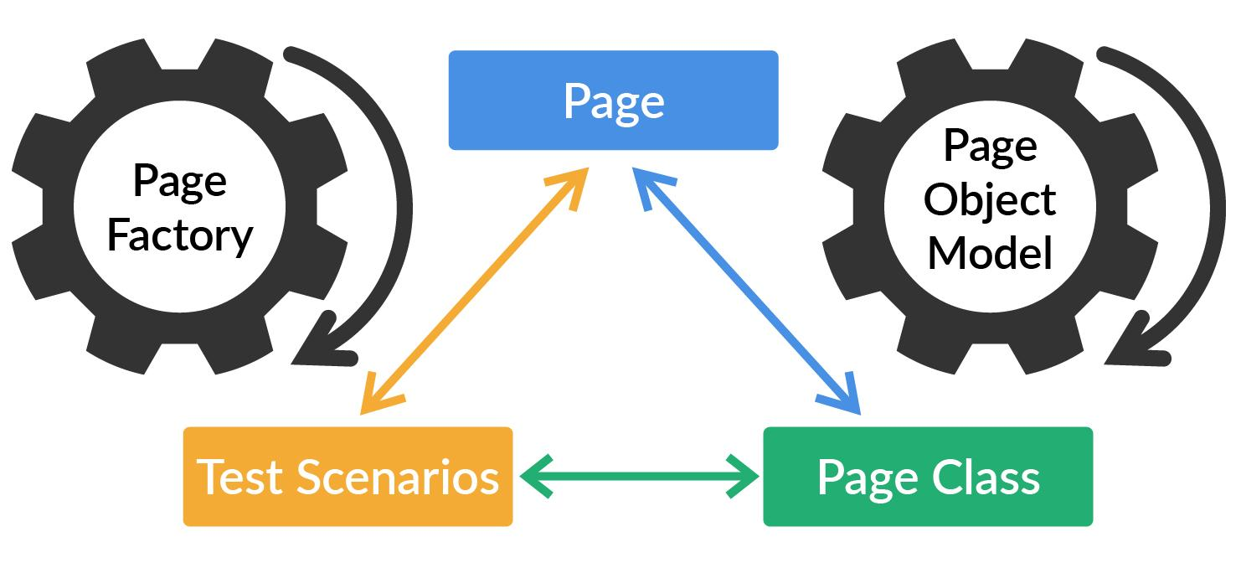
Page Object Model (POM)
Page Factory
Page Factory is a class provided by WebDriver to support the Page Object Design pattern. In Page Factory, one can use the @FindBy annotation and the initElements method to initialise web elements.
The @FindBy annotation is used in Page Factory to locate and declare web elements using different locators.
initElements() is a static method in the Page Factory class, which one can use to initialise all the web elements located by the @FindBy annotation.

Slide 27
Hands-On Exercise 1 (5 mins)
Draft a structure of POM for zomato website.
Landing page
Search page
You can see a sample answer here.

Slide 28
Poll 4 (15 Sec)
What is true about Page Object Model (POM)?
(Note: More than one option may be correct.)
In POM, every web page in an application should have its own page class.
The user actions on a particular web page should be stored inside the page method of that particular web page’s page class.
There should be only one page class for the entire application.
All of the above.
Practice in teams of 4 students
Industry expert mentoring to learn better
Get personalised feedback for improvements

Slide 29
Poll 4 (Answer)
What is true about Page Object Model (POM)?
(Note: More than one option may be correct.)
In POM, every web page in an application should have its own page class.
The user actions on a particular web page should be stored inside the page method of that particular web page’s page class.
There should be only one page class for the entire application.
All of the above.
Practice in teams of 4 students
Industry expert mentoring to learn better
Get personalised feedback for improvements

Slide 30
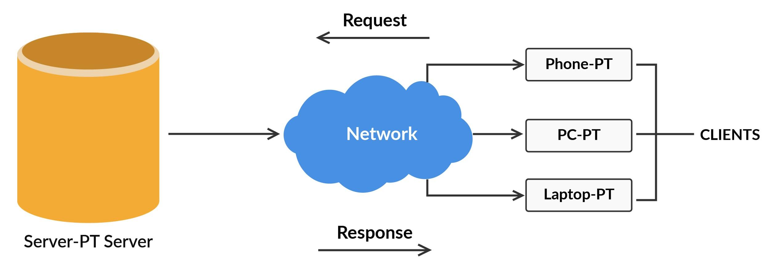
HTTP Response Codes

Slide 31
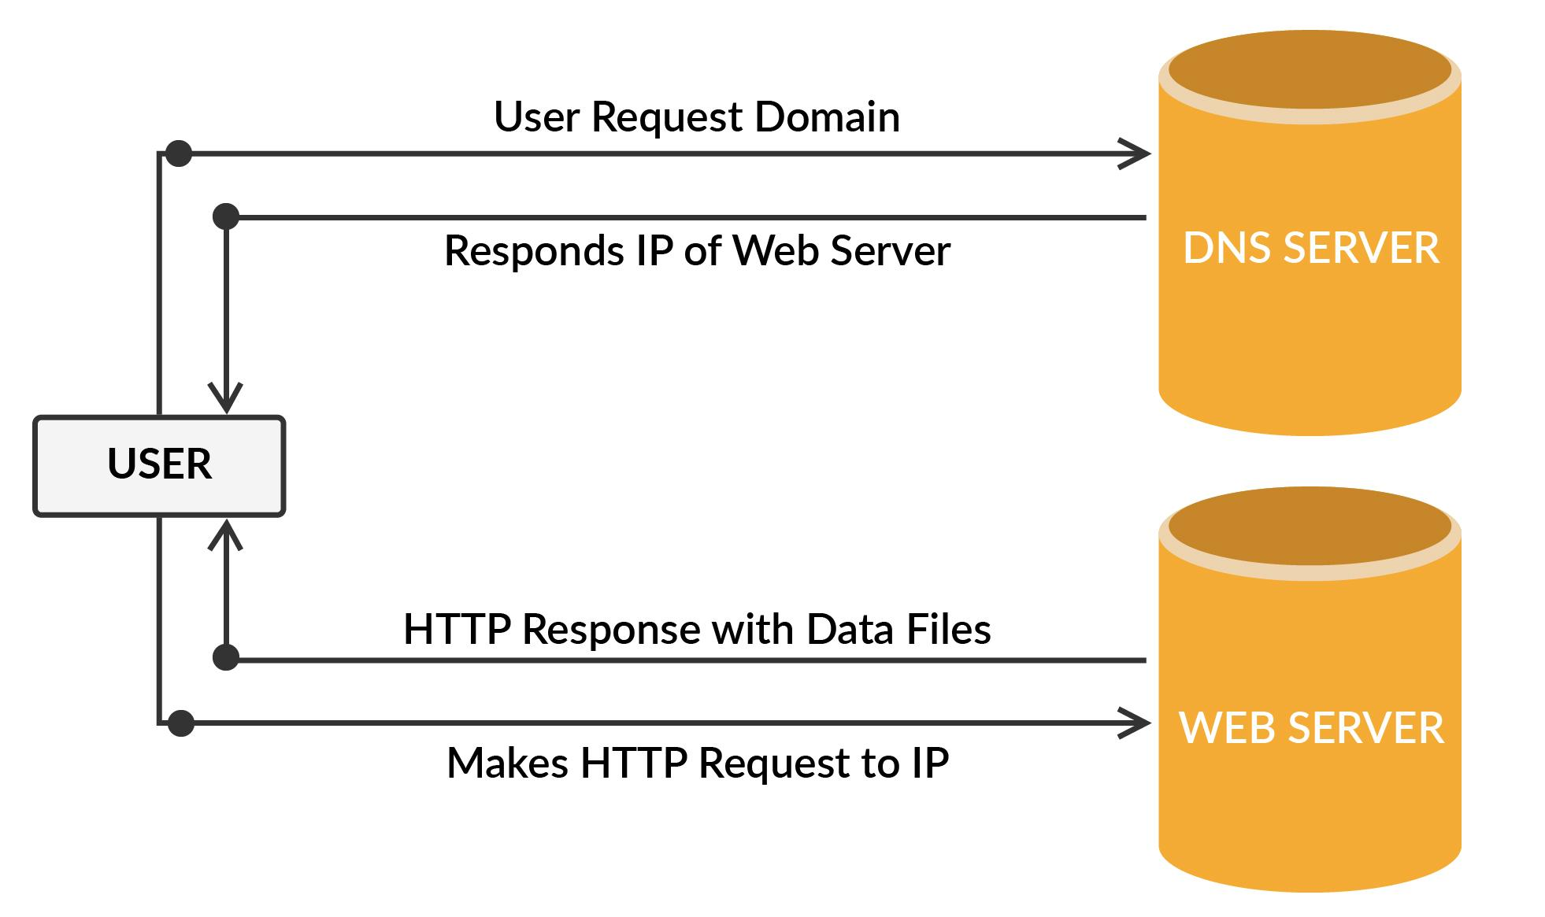
HTTP Response Codes
Back-end automation is all about interacting with different servers, databases and APIs, and fetching data as and when required. Thus, before getting started with back-end automation testing, let’s discuss a few HTTP response codes that are common while communicating with servers and APIs.
HTTP response codes check whether or not a specific HTTP request has been successfully completed.
HTTP responses are grouped in five major categories, which are as follows:
Informational responses (100–199)
Successful responses (200–299)
Redirects (300–399)
Client errors (400–499)
Server errors (500–599)

Slide 32
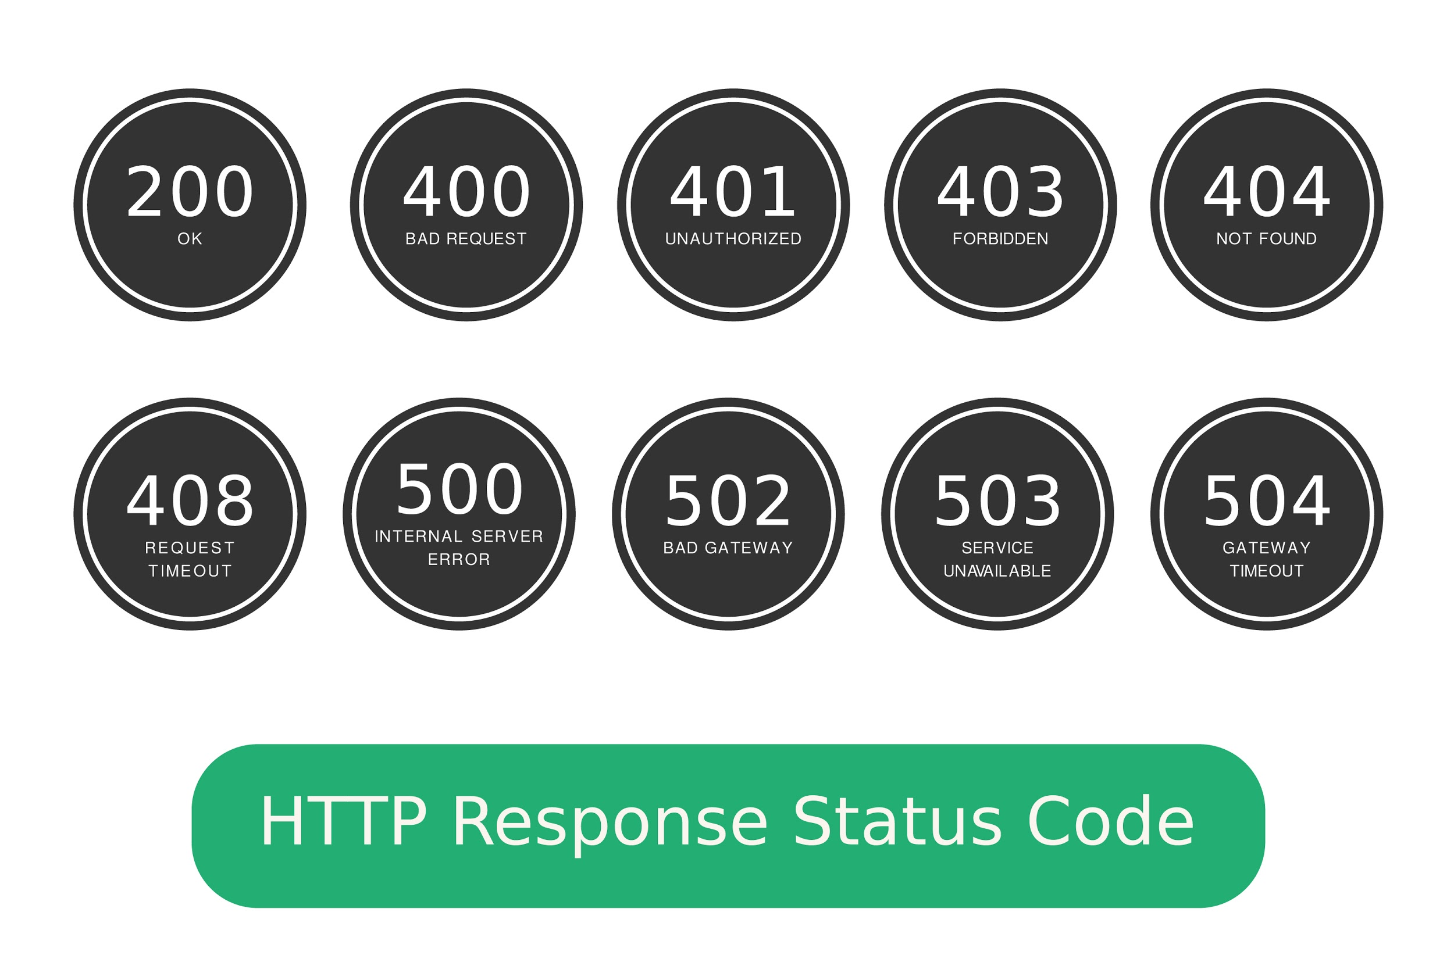
HTTP Response Codes
Most Common HTTP Response Codes

Slide 33
HTTP Response Codes
Most Common HTTP Response Codes
Status Code | Description
200 - OK | This status code shows that the request was successfully carried out.
301 - Moved Permanently | This status code represents that the data that is being requested is not found at the given address and has been moved to a different address permanently.
302 - Moved Temporarily | This status code represents that the data that is being requested is not found at the given address and has been moved to a different address temporarily.
403 - Forbidden | This status code represents that the client who is trying to access the data is not authorised for the same.
404 - Not Found | This status code represents that the requested server is no longer found at the given address.
500 - Internal Server Error | This server response functions as a collection status code for an unexpected server error(s).
503 - Service Unavailable | This server response indicates that the server that is trying to be accessed is currently overloaded.

Slide 34
Front-end testing
Presentation Layer
(UI)
Introduction to Back-End Testing
Business Layer
(API)
Back-end testing
Database Layer
(Database)

Slide 35
Introduction to Back-End Testing
Why Do You Need Back-End Testing?
Most dynamic websites interact with an API or a database to fetch or store data in real time.
In front-end testing, you can only check whether or not the data present on the web page is correct. However, here, you do not know whether or not the data coming from the server is at error or the data stored in the database is correct.
Thus, it is also important to check whether or not the data interaction with the back-end system runs fine, owing to which back-end testing becomes inevitable.
Front-end testing
Presentation Layer
(UI)
Business Layer
(API)
Back-end testing
Database Layer
(Database)

Slide 36
Poll 5 (15 Sec)
Which application layer is API testing part of?
Data layer
Presentation layer
Service/Business layer
API testing can be done on all these three layers
Practice in teams of 4 students
Industry expert mentoring to learn better
Get personalised feedback for improvements

Slide 37
Poll 5 (Answer)
Which application layer is API testing part of?
Data layer
Presentation layer
Service/Business layer
API testing can be done on all these three layers
Practice in teams of 4 students
Industry expert mentoring to learn better
Get personalised feedback for improvements

Slide 38
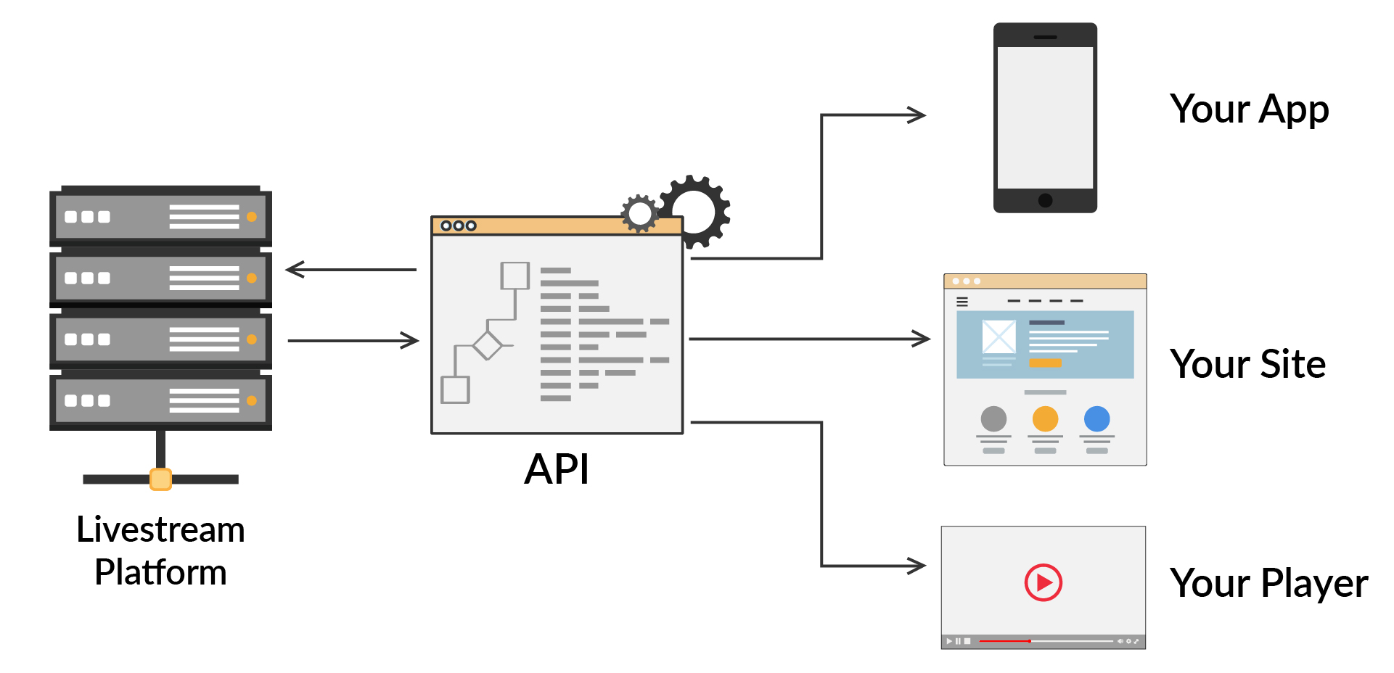
Introduction to Back-End Testing
What Is an API?
Application Programming Interface(API) is an interface that takes the request from the user and gives the response.
Let’s consider the following example to understand what an API is.
Suppose you are looking to book a flight through a website that compares the rates of multiple flights and gives you the best results. So, here, when you enter the details of your trip, the application sends the data request to the APIs of all the official flights and after getting the response from those APIs, the application collates the data and presents it to you.

Slide 39
Introduction to Back-End Testing
API Testing
API testing is used to examine Application Programming Interfaces (APIs).
It checks the functionality, reliability, performance and security of programming interfaces involved in an application ecosystem.
APIs are the connecting nerves between different systems or layers of an application.
Applications often have three layers: Data layer, service (API) layer and presentation (UI) layer.
Here, the API layer holds the business logic of an application, i.e., the rules that define how users can interact with the services, data or functions of the application. Since the API or the service layer interacts directly with both the data layer as well as the presentation layer, it provides the sweet spot for continuous testing by the QA team.

Slide 40
Introduction to Back-End Testing
API Testing
The four main methods involved in API testing are as follows:
GET:
This method is used to extract data from the given URL. It does not modify the data.
POST:
This method is used to send user data to the server. It can also be used to create a new entity.
PUT:
This method is used to either create a new entity or update an already existing entity.
DELETE:
This method is used to remove all the resources provided by the given URL.

Slide 41
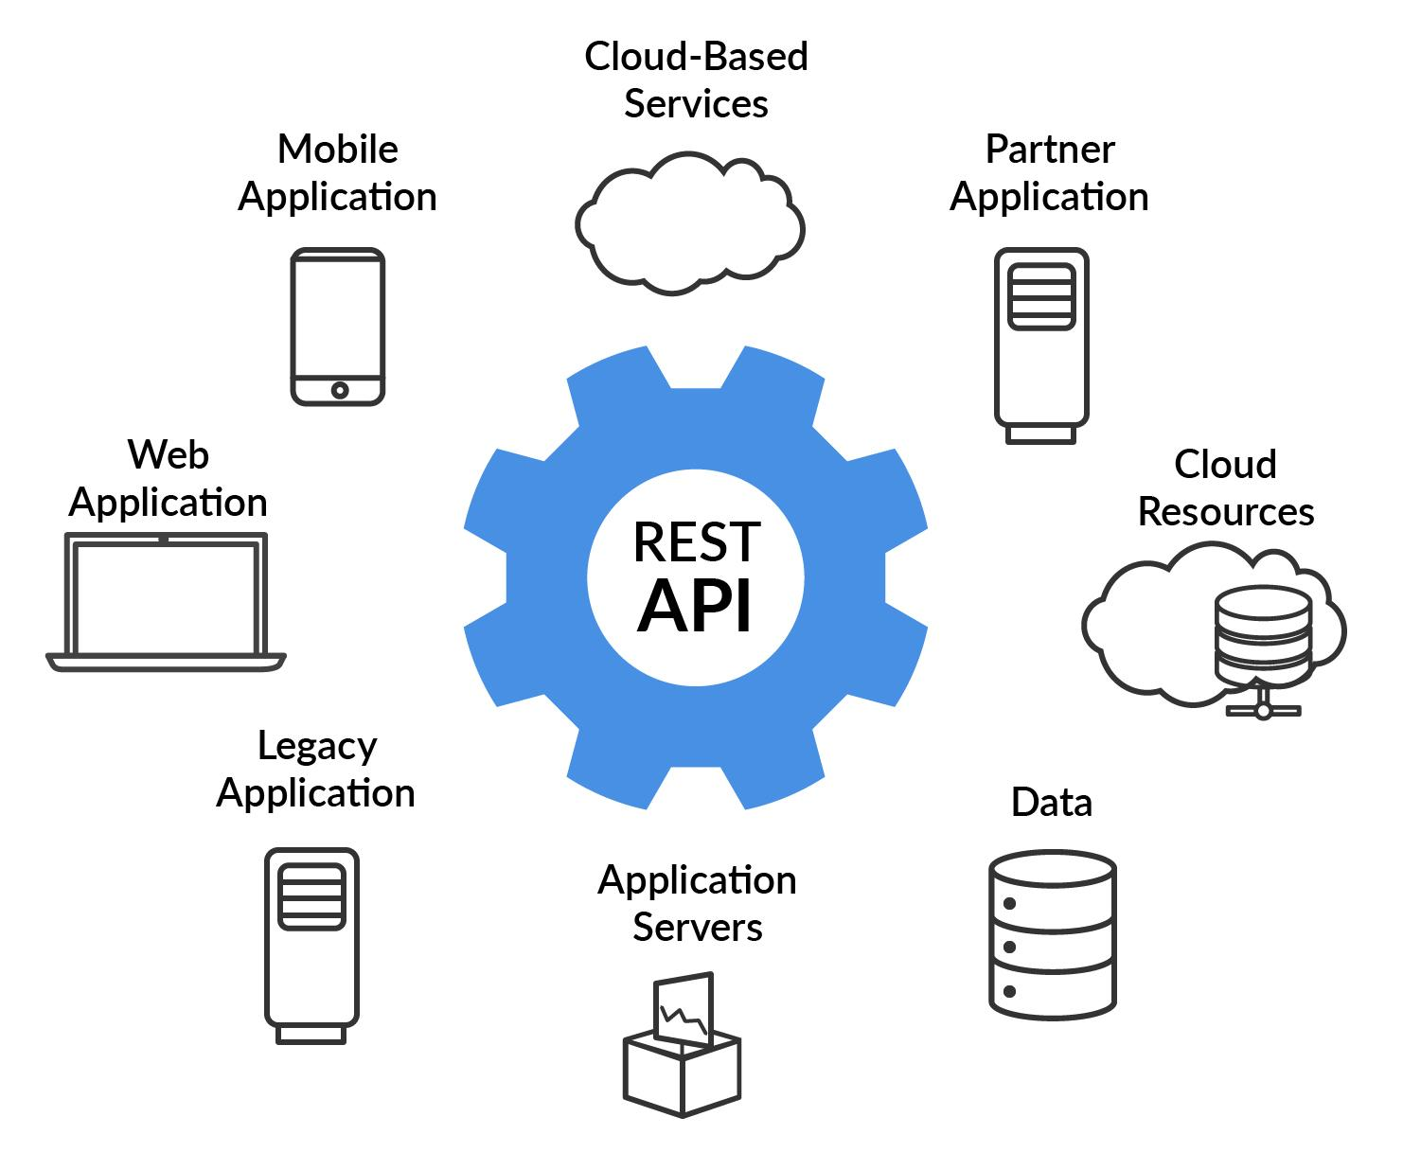
Introduction to Back-End Testing
REST API
REST is acronym for REpresentational State Transfer.
The key abstraction of information in REST is a resource.
Any information that can be named can be a resource (document / image, collection of other resources, non-virtual object, etc.). REST uses a resource identifier to identify a particular resource involved in an interaction between different components.

Slide 42
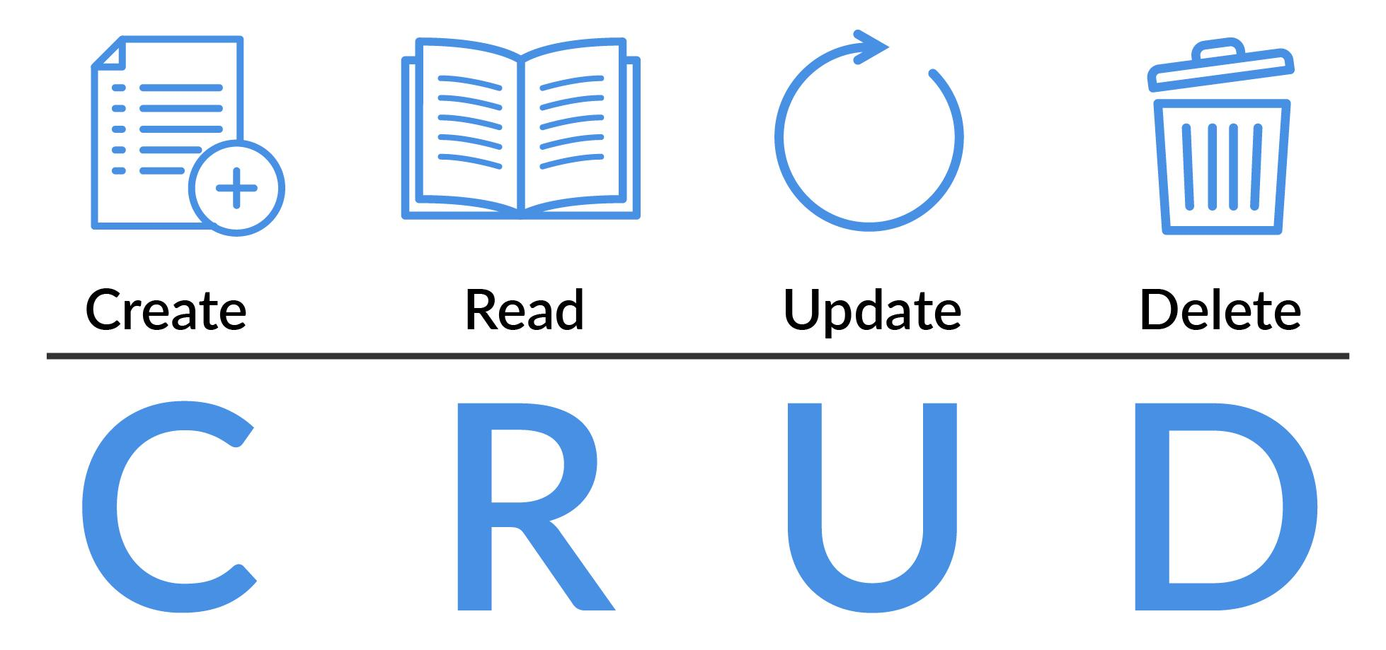
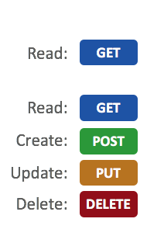
Introduction to Back-End Testing
CRUD
CRUD is an acronym for Create, Read, Update and Delete.
CREATE procedures generate new records via INSERT statements.
READ procedures read the data based on input parameters. Similarly, RETRIEVE procedures grab records based on input parameters.
UPDATE procedures modify the records.
DELETE procedures delete the specified data.

Slide 43
Poll 6 (15 Sec)
The CRUD operation 'Update' corresponds to which HTTP method?
GET
POST
PUT
DELETE
Practice in teams of 4 students
Industry expert mentoring to learn better
Get personalised feedback for improvements

Slide 44
Poll 6 (Answer)
The CRUD operation 'Update' corresponds to which HTTP method?
GET
POST
PUT
DELETE
Practice in teams of 4 students
Industry expert mentoring to learn better
Get personalised feedback for improvements

Slide 45
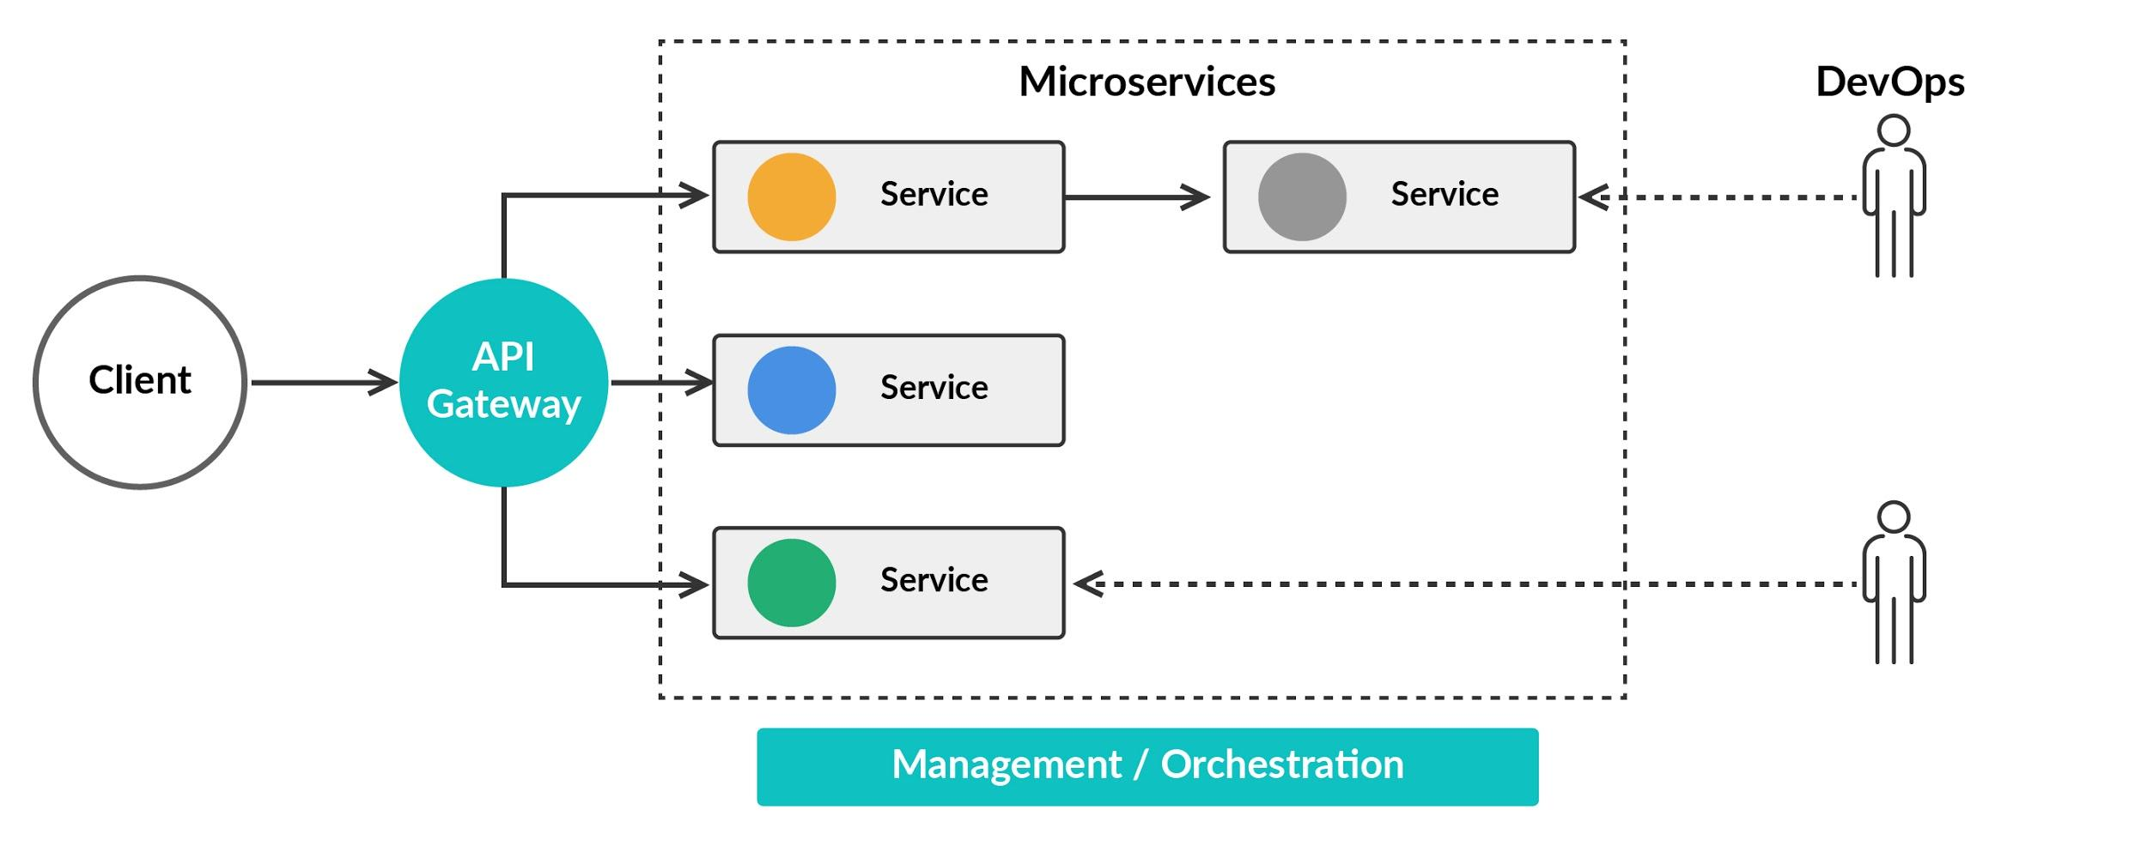
Introduction to Back-End Testing
What Are Microservices?
Microservices solve the challenges of monolith systems.
The microservice architecture helps in building a bigger application in a modular way by dividing the entire suite into small services such that each service runs its own process.
As smaller services run on their own, they can be independently deployed and tested.
Thus, if one service breaks, the other services will not be affected.

Slide 46
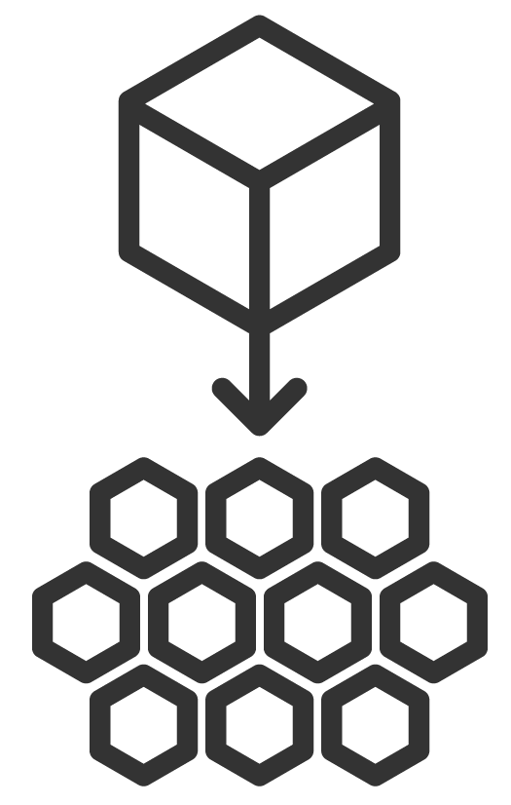
Introduction to Back-End Testing
Microservices Testing
Testing microservices has become an important part of back-end testing, as many applications today are built using the microservice architecture.
The different tests that can be performed on microservices are as follows:
Unit Test: As you already know, in unit testing, you can test each module separately to check whether or not it functions as desired Moreover, as microservices are small chunks of services, you need to test those services at the granular level owing to which you need to perform a thorough unit testing.
Component Test: After you have thoroughly tested the functions inside a microservice, you need to test whether or not the microservice, as a whole, functions as expected, and this is confirmed using component testing.
Integration Test: After each microservice is tested, you need to test how different microservices communicate, and check whether or not the results obtained are as expected.

Slide 47
Poll 7 (15 Sec)
What is true about a microservice?
It is the process of breaking a bigger application into smaller, lightweight services.
The services can communicate with each other over HTTP.
It is a distributed system design.
All of the above.
Practice in teams of 4 students
Industry expert mentoring to learn better
Get personalised feedback for improvements

Slide 48
Poll 7 (Answer)
What is true about a microservice?
It is the process of breaking a bigger application into smaller, lightweight services.
The services can communicate with each other over HTTP.
It is a distributed system design.
All of the above.
Practice in teams of 4 students
Industry expert mentoring to learn better
Get personalised feedback for improvements

Slide 49
POJO in Rest-Assured
serialization: Convert employee class object to JSON representation
deserialization: Reverse of serialization, i.e., convert a JSON object back to employee class object

Slide 50
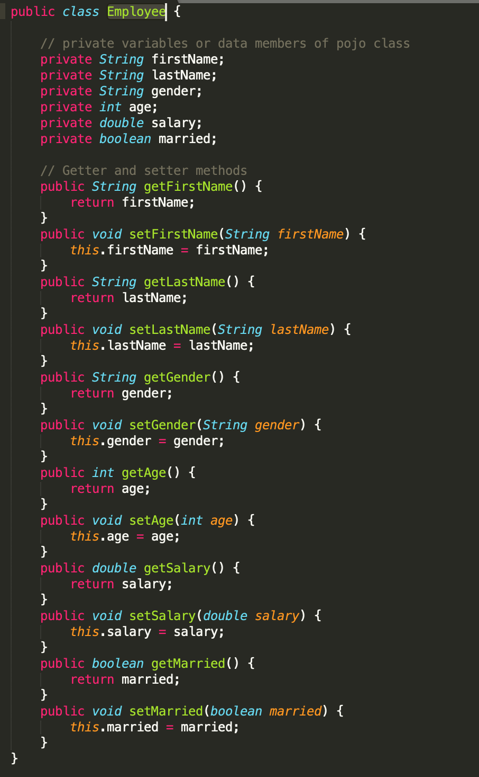
Introduction to Back-End Testing

Slide 51
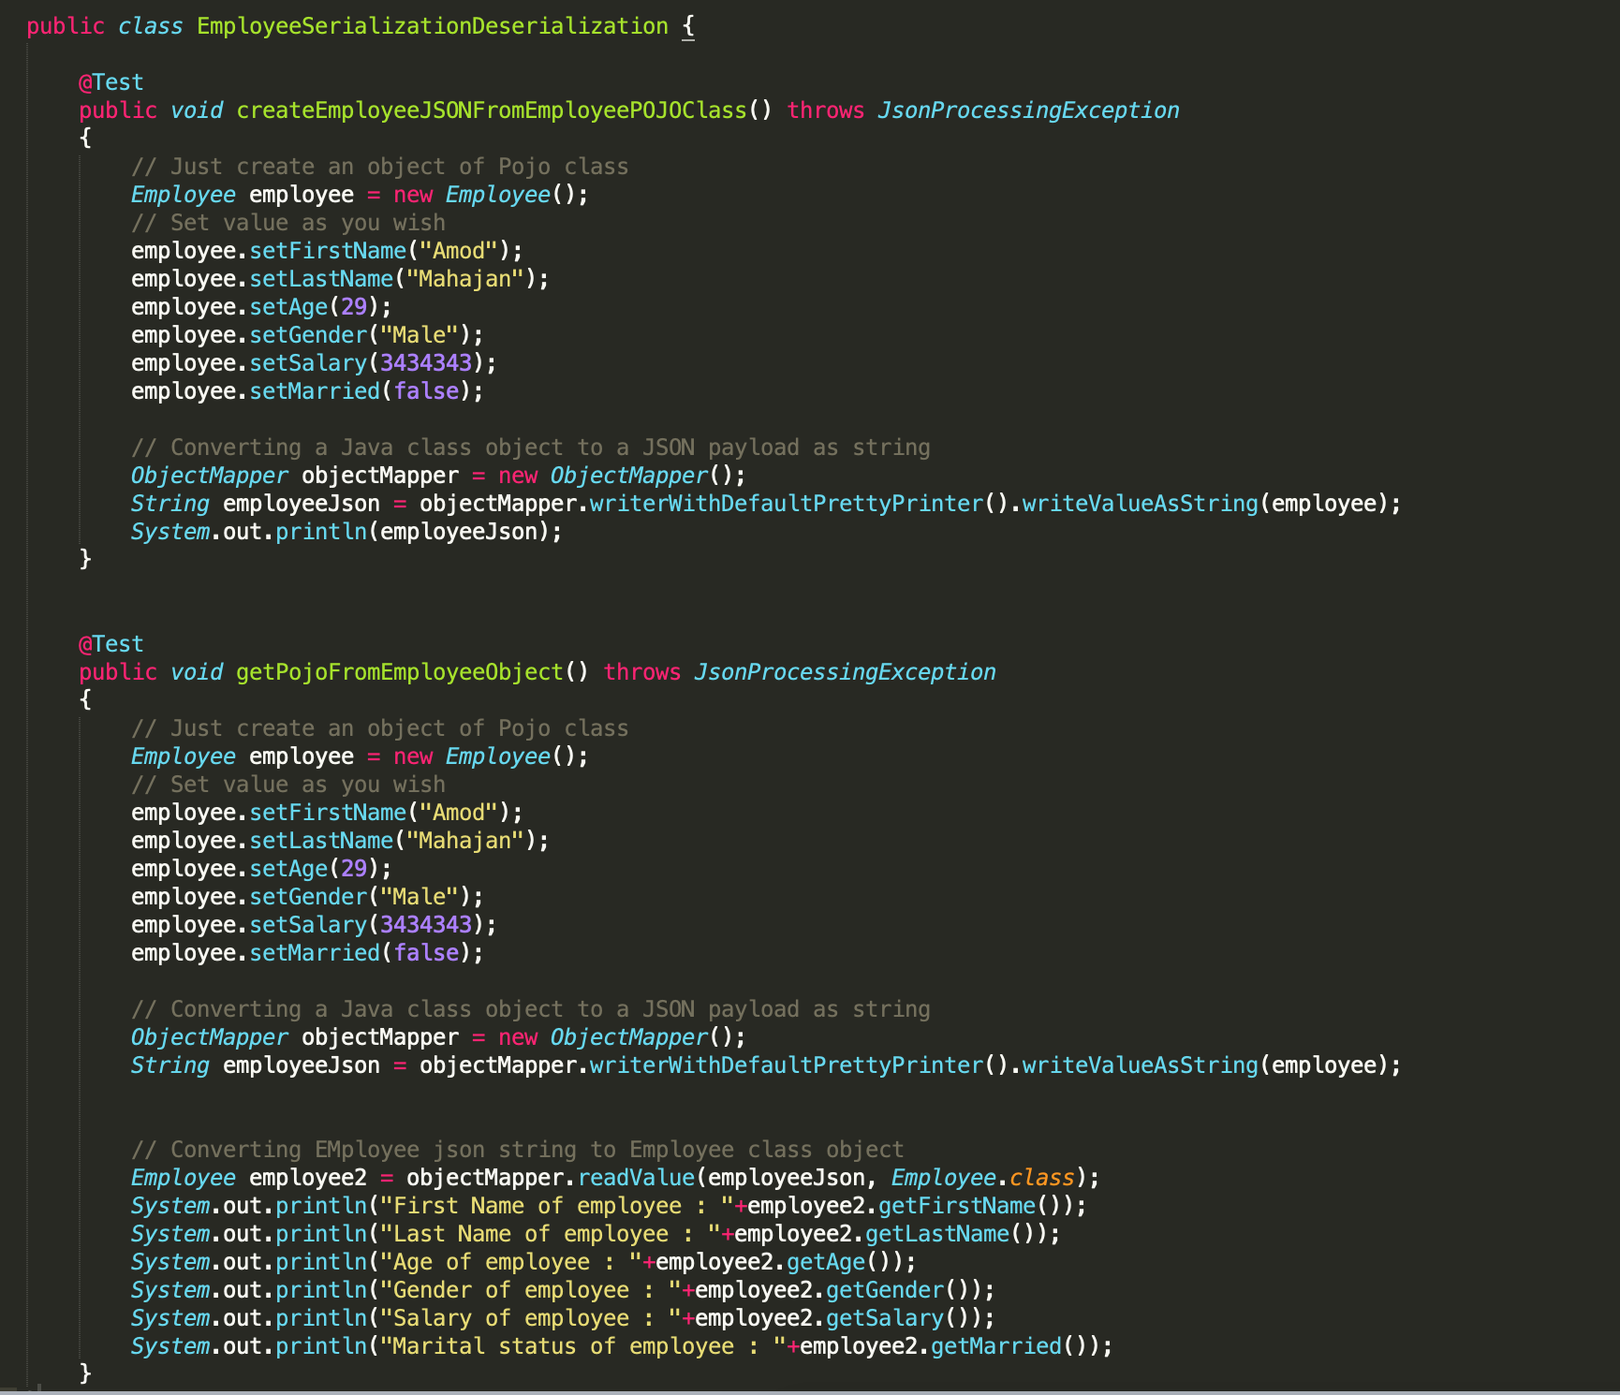
POJO in Rest-Assured

Slide 52

Project Work (30 min)
Online Food Ordering Website
Let’s automate a simple GET API hosted at developers.zomato and set up a Maven project.
You can refer to the solution here.

Slide 53
Key Takeaways
You learnt about the importance of using test automation frameworks and understood in detail how data-driven framework works and is implemented.
You also learnt about Page Object Model (POM) and its importance in building test scripts.
Then, you looked at back-end testing and understood why it is important.
Next, you learnt about different APIs and understood why testing APIs is an inevitable part of back-end testing.

Slide 54
Doubt Clearing (15 min)

Slide 55
Tasks to Complete After Today’s Session
MCQs
Project - Checkpoint 3

Slide 56
In the next class...
You will learn about back-end automation testing.

Slide 57
#RahoAmbitious
Thank You!

